Slide 1
Pros & Cons of Social Media
Channels in Marketing
Name:
Course ID:
Date:

Slide 2
Diversity of Social Media Channels
Facebook
Twitter
You tube
We Chat
Instagram
Snap chat
WhatsApp
Tiktok
Telegram
LinkedIn

Slide 3
Facebook
Access to wide market due to its popularity (over 2 billion users globally).
Better targeting capabilities through specific ads and features.
Direct engagement with customers though dialogues and messaging.
Easy to access performance analytics.
Needs great deal of time and effort to maintain pages.
Better engagement requires pay to play capability.
Ease of negative rating through comments that might hurt reputation.
Notes:
Facebook offers a great opportunity to reach a wide audience but also means great commitment to maintain the page, including managing negativity that may have adverse impacts on the brand.
While most of Facebook advertising is free, pay to play offers better engagement where paid ads reach audiences swiftly and more efficiently (Mullen, 2018).

Slide 4
Twitter
Pros
A wider reach on the market due to the large user base.
Convenient two-way communication to offer customer support.
Effective to gather feedback.
Easy to drive up brand popularity through twitter trends.
Cons
Time and efforts commitment in actively maintaining a twitter page.
Easy of getting negative criticism.
Time sensitivity is important, otherwise followers may miss key updates.
Spamming problem including fake profiles that may ruin a brand.
Notes:
Twitter is fast and efficient for brand communications. However, time is key because some users may miss on the information posted.
It is also a relatively cheap platform but requires efforts and time to management effectively (Birkett, 2020).
Spamming and other forms of negativity can easily dent the image of a brand.

Slide 5
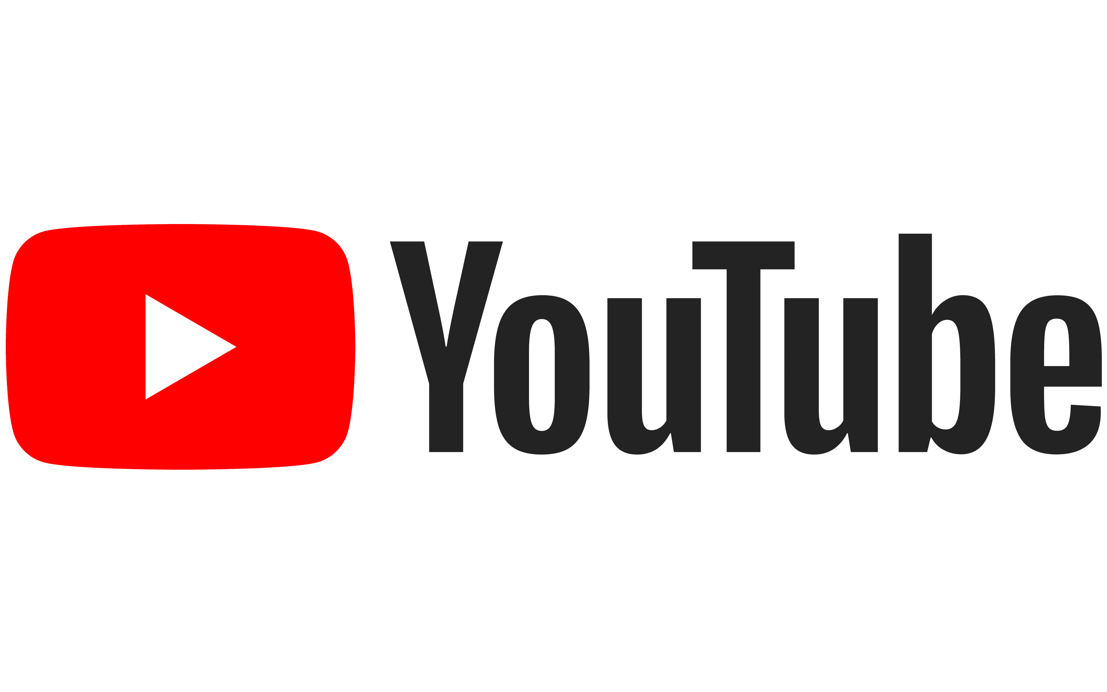
Pros
A wider reach on the market due to global reach.
Best for ultra-targeted advertising.
Uses videos which are most engaging media on the social platforms
Cons
Limited to only video sharing
Lack of control over the ads that appear.
Costly and much efforts needed to maintain YouTube account.
Notes:
As a globally accepted video sharing platform, YouTube is convenient for selling.
It is however quite costly to run marketing activities aside from much time and efforts committed into it.
It is however ideal platform for marketing functions all over the world
- Donio (2018)

Slide 6
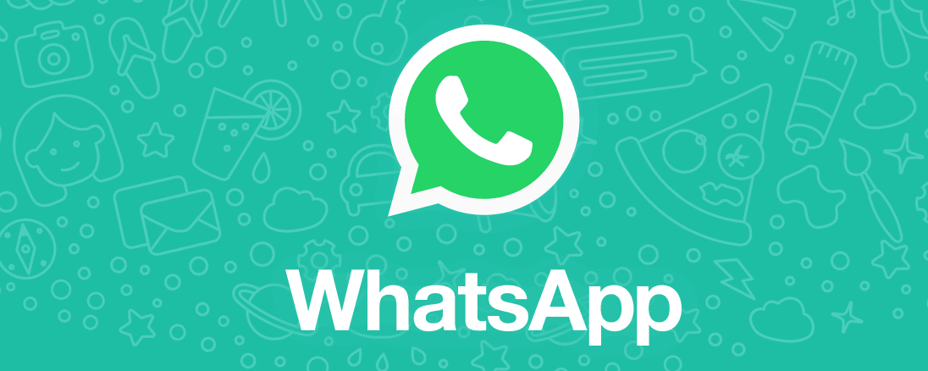
Allows for quick real-time communication essential for customer support.
Large user base thus the messages reach widely.
One can send diverse multimedia; videos, text, audio and photos instantly.
Free to operate.
Hard to retrieve a specific message in a string of chats.
Has no specific features for business-oriented communication.
Hard to customize to one’s need.
Notes:
While WhatsApp is an excellent tool for communication, and easy to operate, there is no customization. No features exist to make is uniquely tailored to business/marketing commination. Otherwise, almost everyone is on WhatsApp which makes it convenient to reach wider audiences (Leads Dubai, 2020)

Slide 7

Instagram
Pros
Very convenient for detailed targeting to offer more value and impact on the market.
Diversity of multimedia messaging allowing for eye-catching messaging.
Special features such as Collection Ads for more aggressive marketing.
Cons
Since it is visual site, care is taken on content applied. For instance, poor quality images can be easily skipped.
Limited availability only on iPhone and Android users.
Does not support clickable links due to limited characters allowed.
Notes:
In Instagram, detailed targeting can be in terms of certain interests, locations, behaviors, and demographics among others.
Collection Ads was rolled out in early 2018 allowing the use of photos and videos to highlight products and enable outright purchasing without existing leaving the site (Key Media Solutions, 2016).
The captions on Instagram are only 125 to 150 characters thus can be more restrictive if a brand needs to share links. Ultimately, it affects the conversion rates to determine success to engage with the brand.

Slide 8
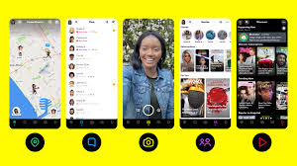
Snap chat
Direct engagement of users through creation of stories.
Very impressive interactive ways to communicate to audiences.
Quite cumbersome such as in reposting images.
Saturation and thus difficult to make repeat engagements.
Notes:
Certain complications in use as well as market saturation mean that the app may not be so effective in main repetitive engagements (Guven, 2020).
Otherwise juts like Instagram, snap chat is a very interactive and visual platform

Slide 9
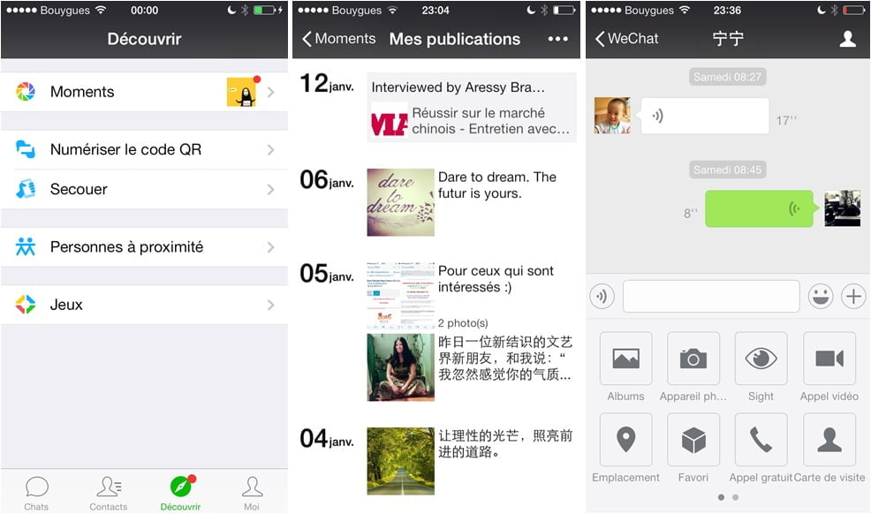
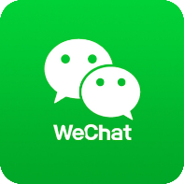
We Chat
Lots of freedom to interact due to utilities.
On-site payment capabilities.
Easy recharging balances and withdrawals.
Restriction to sending messages especially for a service account.
The App is not monetary oriented and thus difficult to get data for analytics.
Notes:
On We Chat, a service account has custom-menu functionality that works almost as a mini-site embedded in the We Chat platform, but it allows only one message per month. A subscription account allows, at most, two messages per day, but with less advanced functionalities. (Wang, 2013). There these offer limitations on sending messages to users.

Slide 10

LinkedIn
Pros
A full pay-to-play platform hence greater connections and traffic with less costs.
Longer display time of messages than other social sites.
It is less personal thus attracts serious connections.
Cons
Unavailability of younger audiences
Has rules governing messaging such as rewording to be acceptable for sending.
Limited to 600-character posting.
Notes:
LinkedIn is an excellent site for connections to grow the brand, however it does not appeal to youthful audiences who desire lots of multimedia sharing.
Nevertheless, it is a stable platform to grow brand experience.
- Inc. (2020).

Slide 11

Telegram
Pros
Very secure than other messenger apps with a reliable encryption technique.
Offers fast, real time messaging capabilities
Allows diverse multimedia- pictures, audio, and videos.
Cons
Cumbersome- its contact list is based on phone numbers and therefore requires contact permissions on mobile devices.
No business-specific features to support suitable online selling.
Notes:
Telegram is a fast and Instagram messaging service that helps brands reach out to users effectively.
It is popular among the youths and ideal for targeting this demographic.
It however operates on a contact list which requires permissions to use.
It is a plain platform that offer no specialized features for business.
- Soffar (2015).

Slide 12
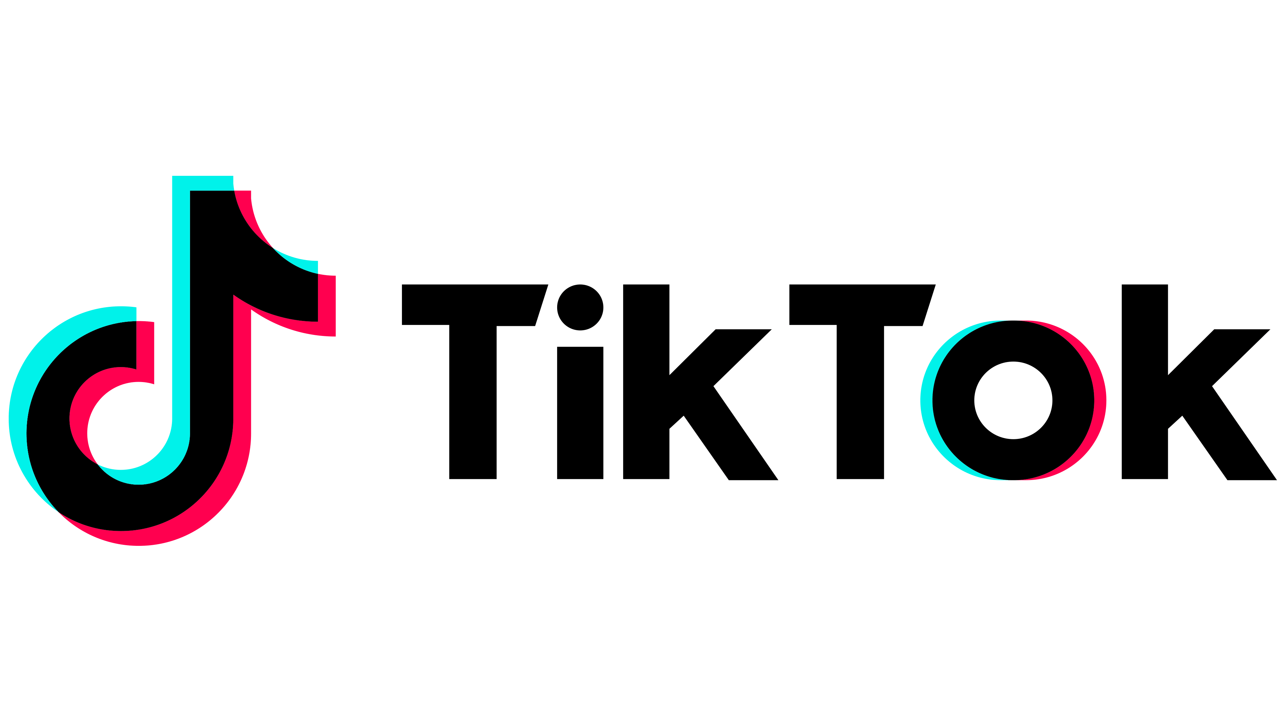


It has a large user base and thus the message reaches broadly on the market.
Allows the freedom of creativity in messaging by use of videos.
Ads play automatically.
Messaging is limited to video presentations.
Running of ads is expensive.
Does not appeal to +30 year olds.
Notes:
This platform is essential to reach a high user base due to creativity in the use of videos. However, this is in itself a disadvantage since no other forms of messaging is allowed.
It is also a costly platform where with no pay and play capabilities.
It is also best suited to teenagers an d you adults not much to adults and middle aged.
- Barraclough (2020).

Slide 13
Ideal Online Strategy
The ideal strategy needs to utilize video, picture, written content instant messaging.
The aim is to offer detailed targeting to specific demographics .
The chosen channels would be:
  Facebook and Twitter (for their large user base)
  WhatsApp & We Chat (for instant messaging)
  Instagram & Snap Chat (for diverse multimedia sharing)
  YouTube (for exclusive video sharing).

Slide 14
Key Performance Indicators
The Follower Count & Variances
Total number of views, shares (retweets), and comments per day (week).
The conversion rates
The Overall Impressions
Web Traffic
Share of Voice

Slide 15
References
Barraclough, D. (2020). The pros and cons of Tiktok advertising. The Upcoming UK. Retrieved on 16 December 2020 from https://www.theupcoming.co.uk/2020/03/20/the-pros-and-cons-of-tiktok-advertising/
Birkett, P. (2020). Twitter For Business: The Pros And Cons Of Using Twitter To Market Your Local Business. Blue Square Management. Retrieved on 16 December 2020 from https://bluesquaremanagement.com/twitter-business-pros-cons-using-twitter-market-local-business/
Donio (2018). The Pros and Cons of Advertising on YouTube. UMG. Retrieved on 16 December 2020 from https://umgagency.com/youtube-pros-cons/
Inc. (2020). The Pros and Cons of LinkedIn Marketing in 2018. Inc.com. Retrieved on 16 December 2020 from https://www.inc.com/young-entrepreneur-council/the-pros-cons-of-linkedin-marketing-in-2018.html
Guven Business Group (2020). Advantages and Disadvantages of Snap chat Marketing. Retrieved on 16 December 2020 from https://www.guvenbusinessgroup.com/blog/Advantages-Disadvantages-of-Snapchat-Marketing
Key Media Solutions (2016). The Pros and Cons of Instagram Advertising. Retrieved on 16 December 2020 from https://keymediasolutions.com/news/pros-cons-instagram-advertising/
Leads Dubai (2018). WhatsApp Marketing Strategy- Pros and Cons of WhatsApp Marketing. . Retrieved on 16 December 2020 from https://leadsdubai.com/whatsapp-marketing-strategy/
Max, S. (2019). Advantages and disadvantage of We Chat. Medium. Retrieved on 16 December 2020 from https://medium.com/@sujatchakma05/advantages-and-disadvantage-of-wechat-5178fca78213
Mullen, A. (2019). The Pros & Cons of Using Facebook to Market Your Business. MI Technology Consulting. Retrieved on 16 December 2020 from https://www.mitcs.com/field-notes/pros-cons-of-using-facebook-to-market-your-business
Soffar, H. (2015). What are the advantages and disadvantages of Telegram? Retrieved on 16 December 2020 from https://www.online-sciences.com/technology/what-are-the-advantages-and-disadvantages-of-telegram/
Wang, X. (2013), Why We Chat Is Not A Good Marketing Tool — Yet. Forrester. Retrieved on 16 December 2020 from https://go.forrester.com/blogs/13-12-10-why_wechat_is_not_a_good_marketing_tool_yet/

